Slide 1
Microsoft Build: Student Developer Drop-In Day
28th May 10AM - 6PM
In Person event

Slide 2
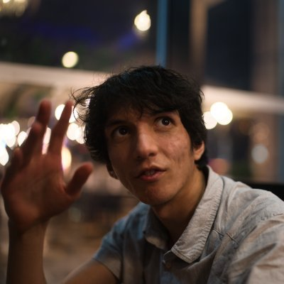
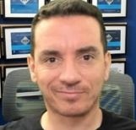
Microsoft Build: Student Developer Drop-In Day
28th May 10AM - 6PM
In Person Event
Salman Chishti
Bruno Capuano
Microsoft Azure & Windows Insider MVP, MCT Regional Lead
Senior Cloud Advocate at Microsoft

Slide 3
Hands up if you use LinkedIn?

Slide 4
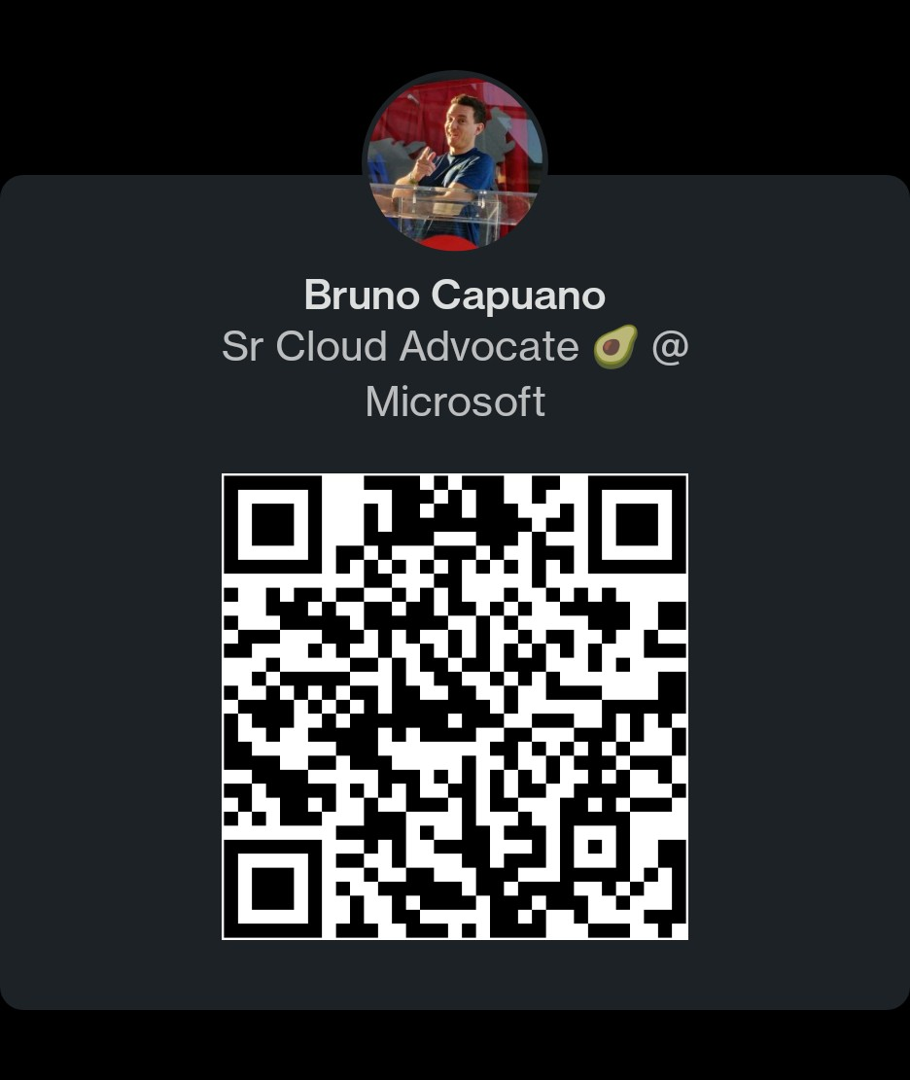
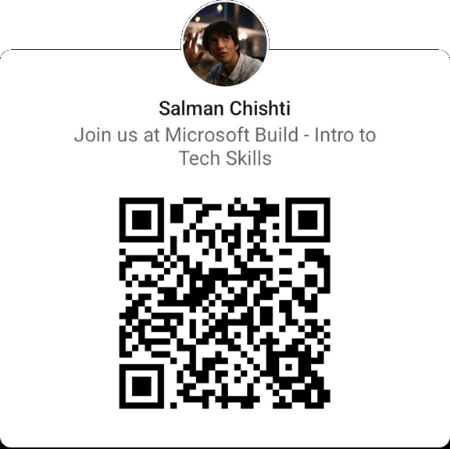
LinkedIn Profiles

Slide 5
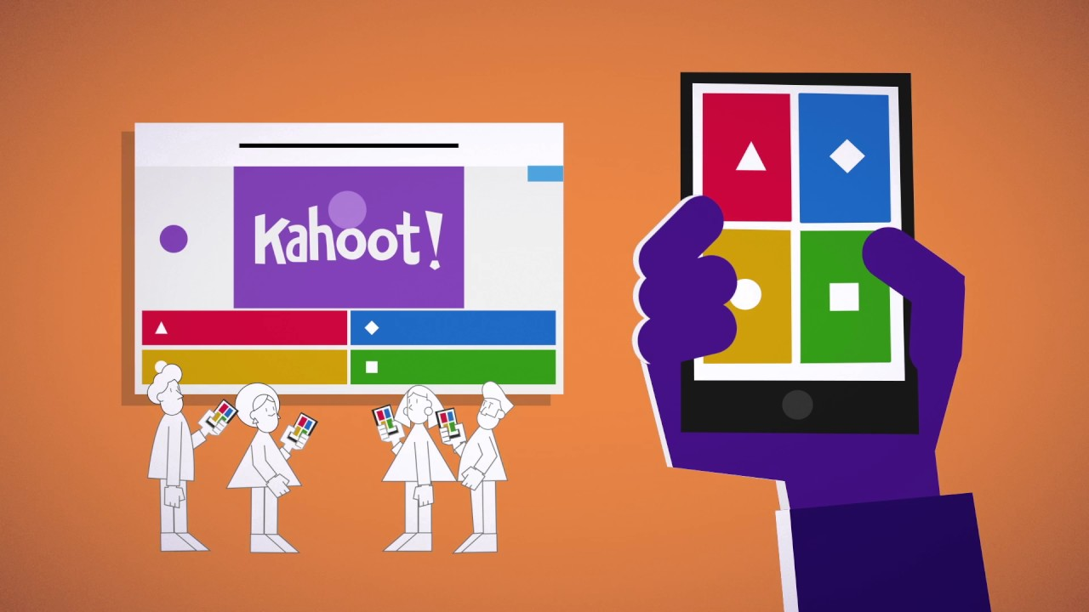
Quiz

Slide 6
Next steps
All the resourcestoday!
Microsoft-Build-Student-Developer-Drop-in-day Resources
Windows Insider Program
Insider.windows.com Cloud Skills Challenge https://aka.ms/StudentDeveloperDayChallenge

Slide 7
Agenda Part 1
10.00 – 10.30
10.30 – 10.40
10.40 – 10.50
11.00 – 12.00
12.00 – 12.40
12.40 – 13.10
13.10 – 13.40
13.40 – 14.20
Welcome to the Student event - Speakers: Someleze Diko and Salman Chishti
Getting Started with Azure for Student - Speaker: Bethany Jepchumba
Getting Started with Microsoft Learn and free student certifications Speaker: Gemma Robson
AI Gaming Challenge Speaker: Stephen Graham AI Gaming
Lunch & Networking
Power Platform Low Code No Code Development Speaker: Bethany Jepchumba
Career Festive – What roles are in Microsoft for interns and Grads Speaker: Gianluca Sanfilippo, Ethan Jones, Rosen Georgiev and Host Aurele Mes Boaye
Introduction to programming hello world in 3 languages Speaker: Bruno Capuano

Slide 8
Agenda Part 2
14:20 – 14:30
Rock your Profile and Resume Builder with LinkedIn​ Speaker: Gianluca Sanfilippo​
14:30 – 14:40
Microsoft Certifications and the road to a tech job​ Speaker Rosen Georgiev​
14:40 – 14:50
Ambassadors showcase - Standing out from the crowd what the ambassadors badge did for me.​ Speaker Salman Chishti​
15:00 – 15:20
Ambassadors showcase - Ambassadors in the community – how to work with your dev community​ Speaker Salman Chishti and Susie Yang​
15:20 – 15:50
Gaming and Azure - Introduction to ID@Azure a new program to help you learn and make successful games using cloud services​ Speaker Bruno Capuano​
15:50 – 16:20
MVP Showcase - Home Automation with the Azure Percept​ Speaker Peter Gallagher​
16:30 – 17:00
Getting Started with Azure Static Web Apps to Host your Resume​ Speaker Bruno Capuano​
17:00 – 18:00
BUILD AI Gaming Challenge Final​ Speakers: Stephen Graham/ Bruno Capuano /Someleze Diko)​
18:00
Close and Celebration.​ Speakers: Someleze Diko Salman Chishti

